Slide 1

Creation of Heatmap using R for the Visualization of Sample Microbial Diversity
Presenter: Emmanuel Tobechukwu Ugwuoji

Slide 2
RESEARCH QUESTIONS
Are there variations in the relative composition of the microbial populations within and across sample?
What is the relative abundance of these microbial groups?
How dissimilar are the samples microbial groups?

Slide 3
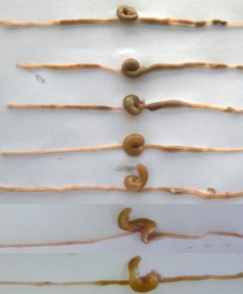
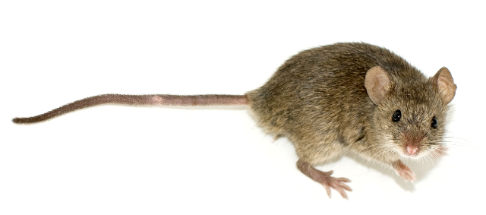
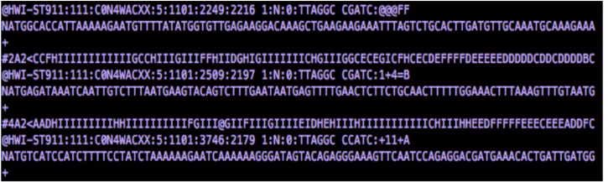

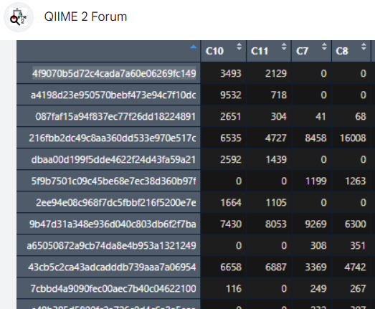
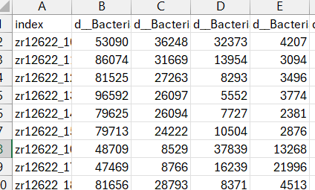
PROJECT OVERVIEW/WORKFLOW
Antibiotic exposure
16S rRNA Metagenomics
Mice
Fastq file containing 16S gene amplicon datasets
Gut content
Read in data
.csv table with read numbers
.asv table with read numbers

Slide 4
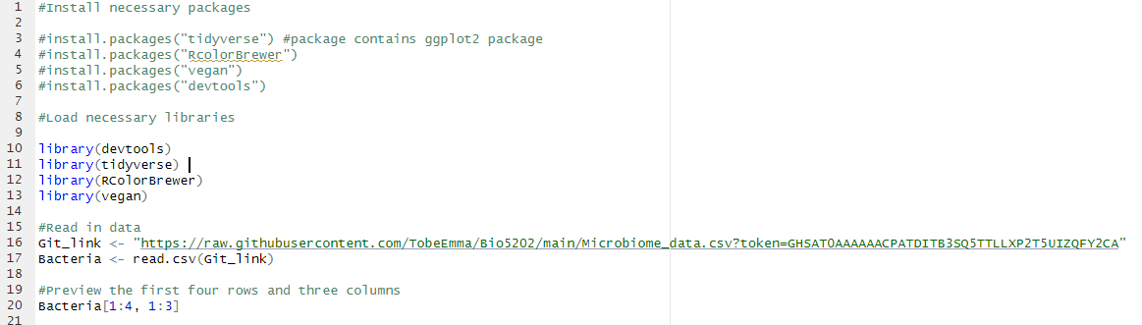
INSTALL PACKAGES, LOAD LIBRARIES AND READ IN DATA

Slide 5
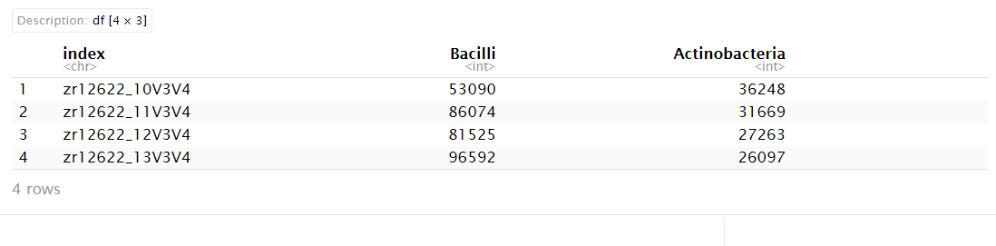
PREVIEW OF THE FIRST FOUR ROWS AND THREE COLUMNS

Slide 6
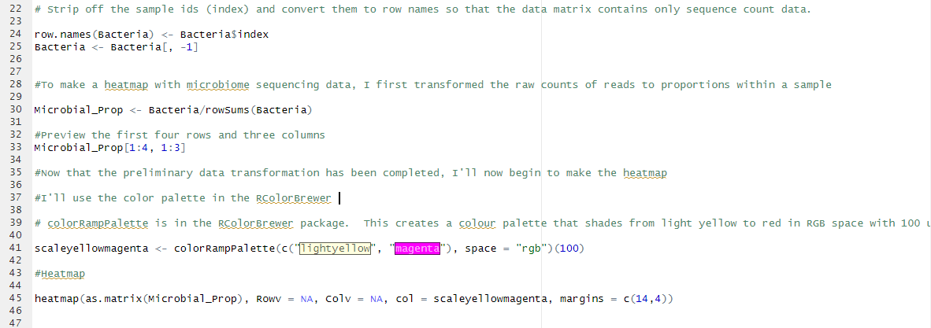
DATA TRANSFORMATION, COLOR PALETTE AND HEATMAP

Slide 7
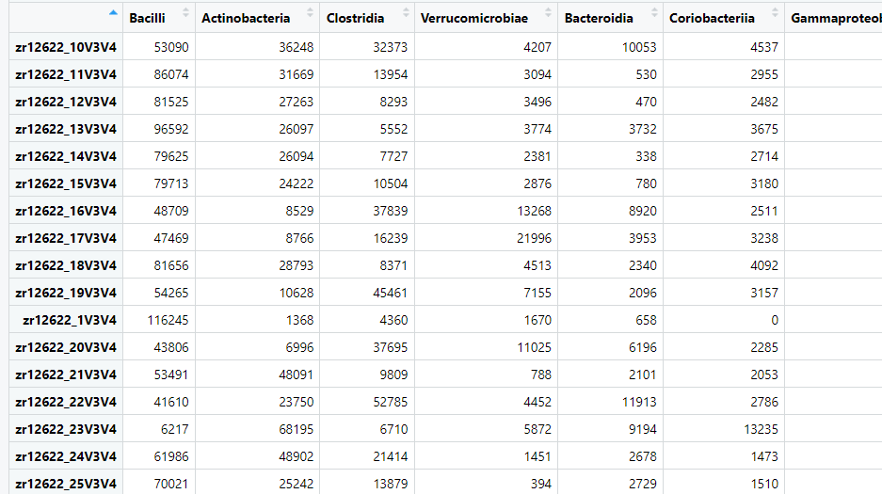
MICROBIOME DATASET

Slide 8
DATA TRANSFORMATION, COLOR PALETTE AND HEATMAP

Slide 9
DATA TRANSFORMATION, COLOR PALETTE AND HEATMAP

Slide 10
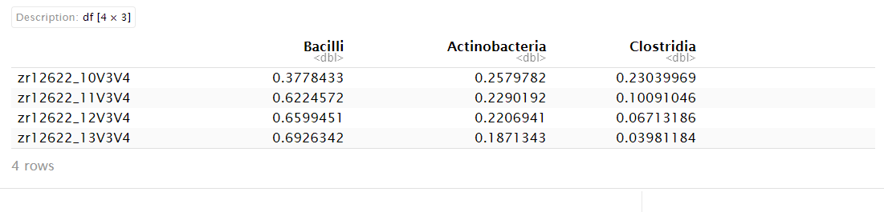
BACTERIAL PROPORTION IN SAMPLE

Slide 11
DATA TRANSFORMATION, COLOR PALETTE AND HEATMAP

Slide 12
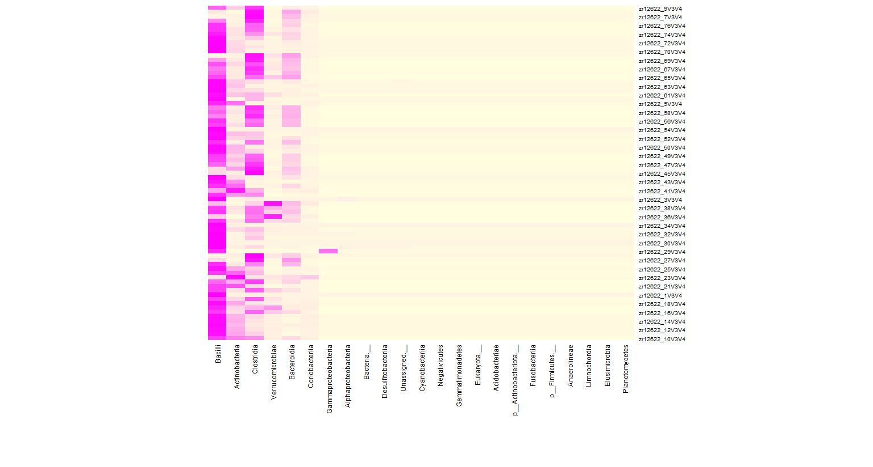
FIRST OUPUT

Slide 13
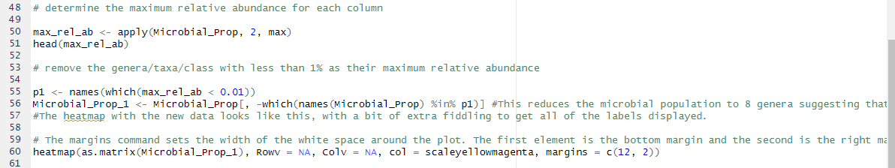

DETERMINATION OF MAXIMUM RELATIVE ABUNDANCE

Slide 14
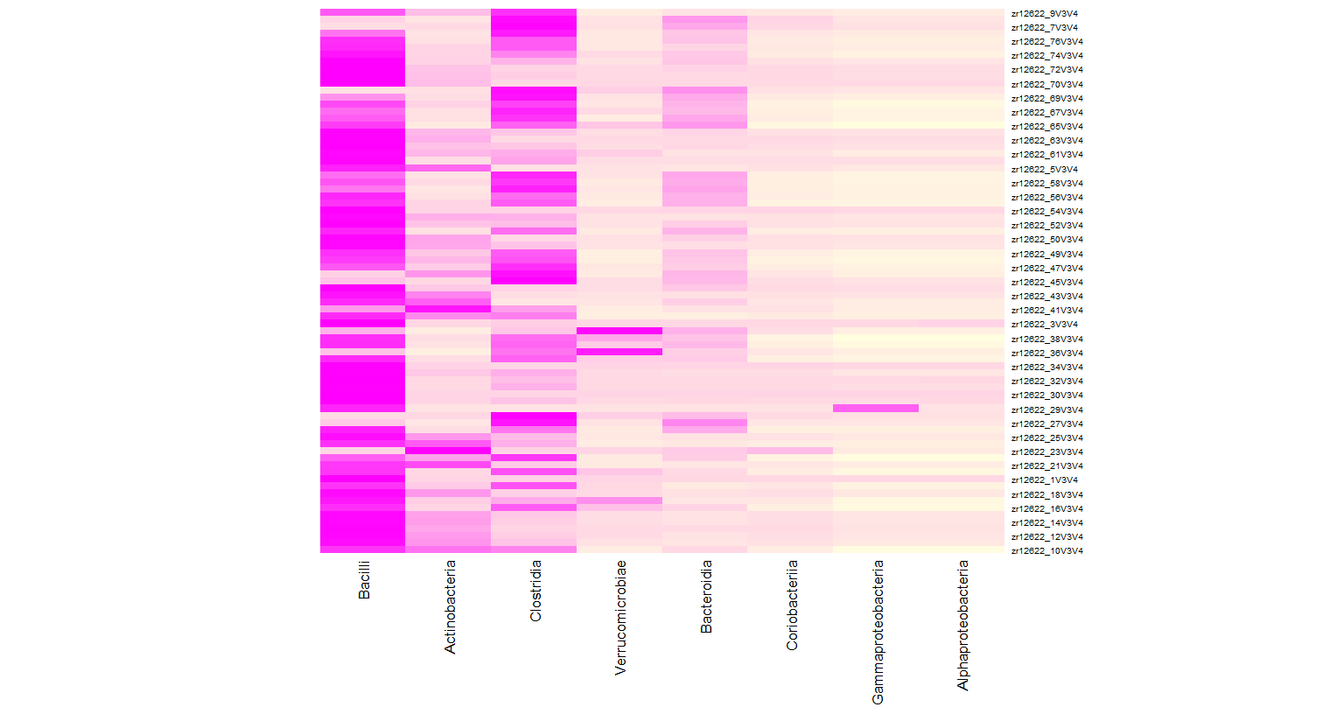
SECOND OUTPUT

Slide 15
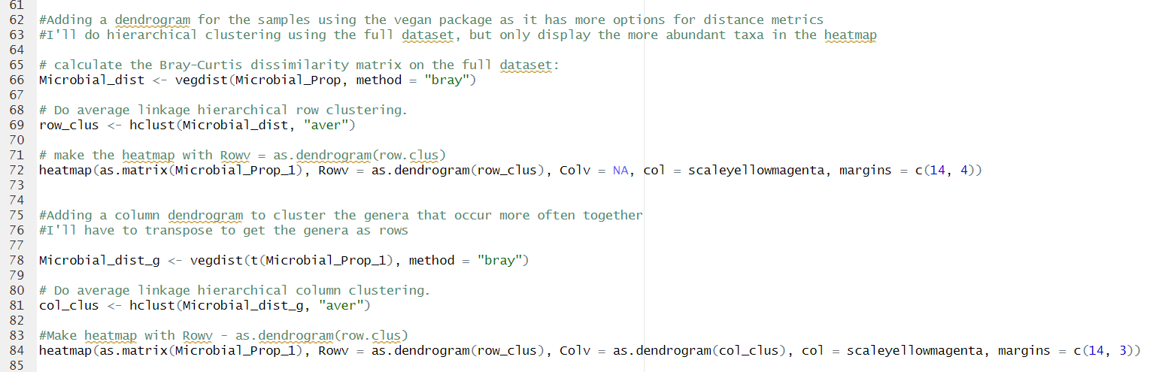
HIERARCHICAL CLUSTERING

Slide 16
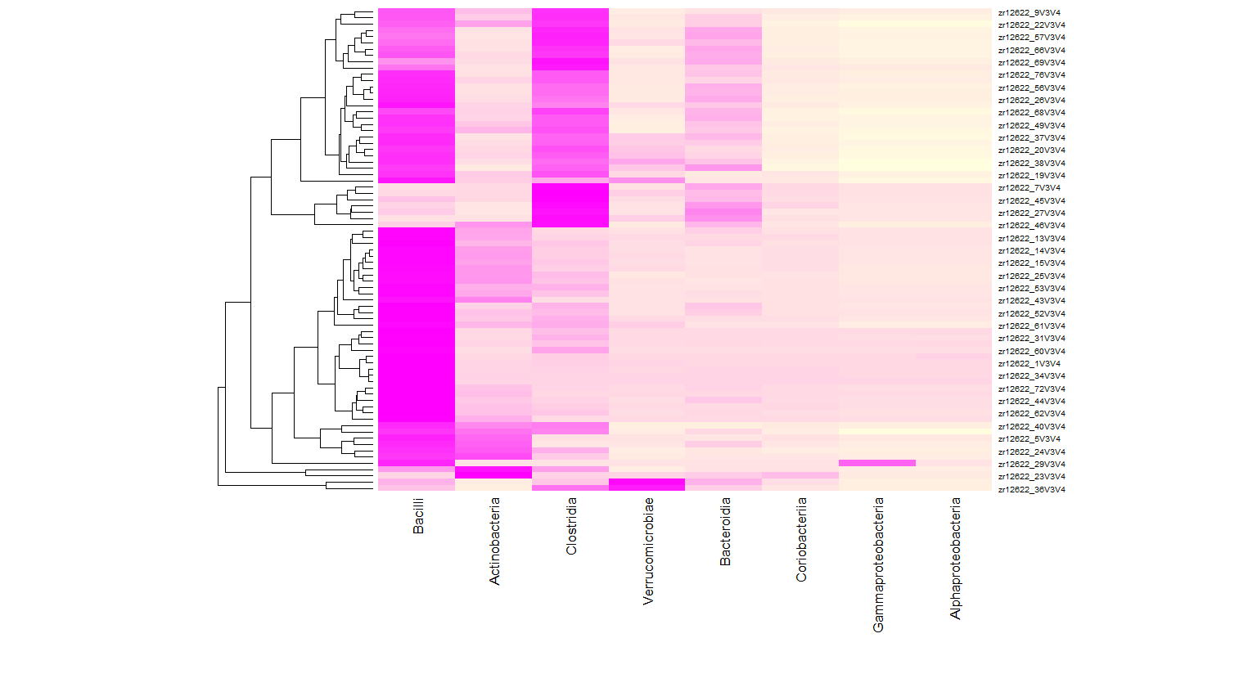
THIRD OUTPUT

Slide 17
HIERARCHICAL CLUSTERING

Slide 18
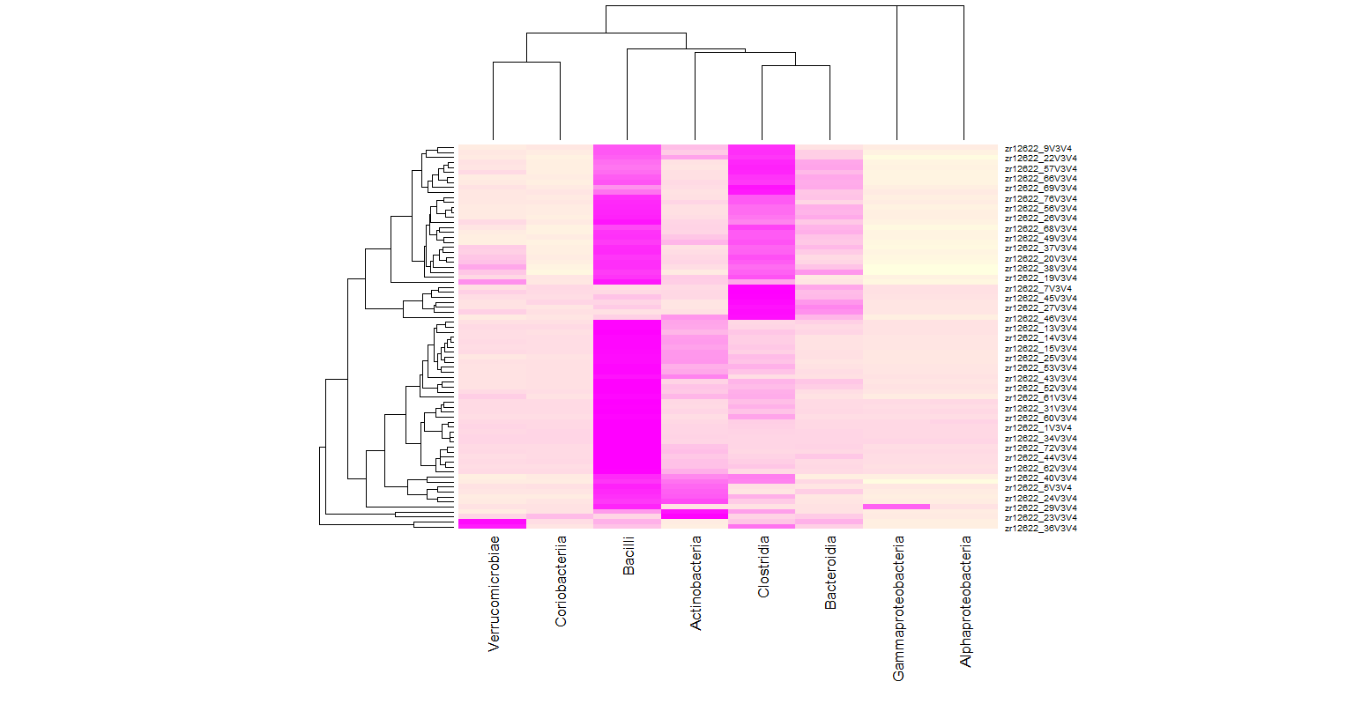
FINAL OUTPUT

Slide 19
CONCLUSIONS
Through the analysis, I was able to understand the relative composition of the microbial populations within and across samples, and
The relative abundance of these microbial groups.

Slide 20
THANK YOU QUESTIONS?

